Slide 1
Trends & Innovations in Rail Freight Transport

Slide 2
How to work with this learning material
Power Point
The following power point presents TRAFFIC TELEMATICS. The slides are shortly described in the notes below, they also provide the link to the source if you need further information.
Reader
In addition to the power point presentation, you can also use the reader provided on our platform. It’s more detailed and can be used as a script for your lessons.
Links
You can find the sources of our presentation and reader in the link section of the relevant bundled teaching material.
Videos
There are different videos used as sources in this presentation. You can find these videos separately in the corresponding section of the relevant bundled teaching material.

Slide 3
Agenda
Trends & Innovations in Rail Freight Transport
Best Practices

Slide 4

Introduction: The Future of Rail
What do you associate with trends and innovations in rail freight transport?
What could rail (freight) transport look like in the future?
Bild: Pixabay
Notes:
Introduction:
You can either use this slide as a starting point or, alternatively, use the remaining suggestions from the collection of warm-up activities .
Use:
Find out about your pupils‘ attitudes towards and knowledge of trends and innovations in rail freight transport. You could proceed in two ways:
Option no. 1 (approx. 5 mins): Give your pupils approx. 1-2 minutes for brainstorming. Afterwards, they can share their thoughts freely without assessment. Group these ideas into categories (e.g. strengths, weaknesses, problems, examples). At the end you can take a photo of the board and make the information digitally available to your pupils. You can always refer back to individual aspects while teaching „trends and innovations in rail freight transport".
Option no. 2 (about 10-15 mins): Hand out two cards to each student (depending on class size), giving them 3 minutes to think about the question at hand and briefly and concisely record their ideas. Then, taking turns, pupils present their thoughts. Put the cards on the board, forming categories (e.g. strengths, weaknesses, problems, examples). At the end, you can photograph the results on the board and make the information available to your pupils. You can always refer back to individual aspects while teaching „trends and innovations in rail freight transport".
Bild: pixabay

Slide 5
Selected Trends and Innovations in Rail Freight Transport
Verkehrsmittel
Innovative Antriebe
Modulare Güterwagen
Infrastruktur
Ausbau der Infrastruktur
Güter-U-Bahn
Intelligente Güterzüge
Magnetschwebe-bahnen
Betrieb
Telematiksysteme im Schienenverkehr
Verbesserung des KundInnenservices
Autonomes Fahren
Interoperabilität
Means of Transport
Innovative Drives
Modular Freight Wagons
Infrastructure
Development of Rail Infrastructure
Underground Freight System
Intelligent Freight Trains
Magnetic Levitation Train
Operation
Telematics Systems
Enhanced Customer Service
Autonomous Driving
Interoperability
Notes:
Innovations include ideas and inventions that are translated into new products and services for the market. Here are some selected trends and innovations in rail transport.

Slide 6
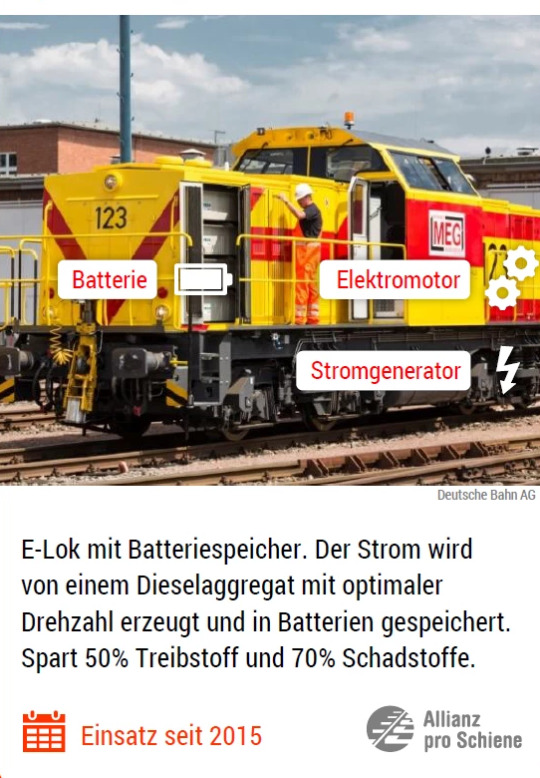
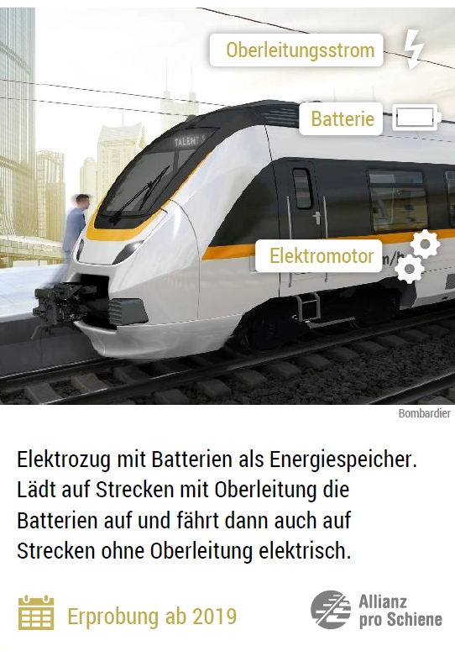
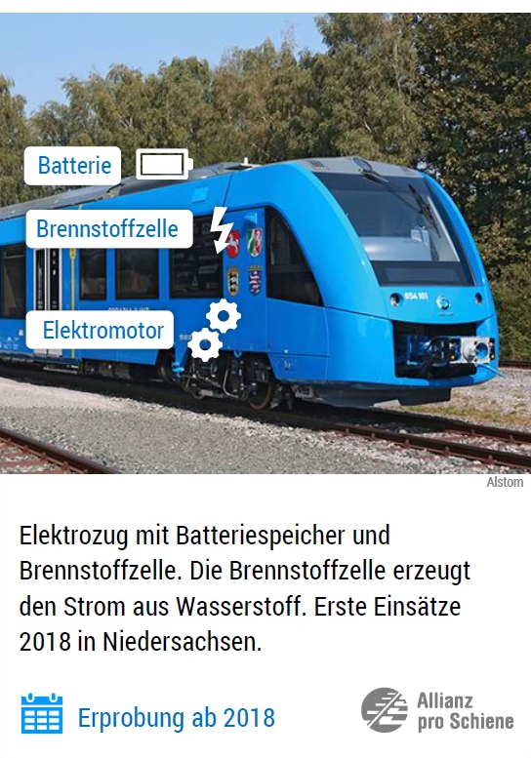
Innovative Drives
Images: Allianz pro Schiene e. V. (adapted)
Current from overhead lines
Battery
Battery
Hydrogen fuel cell
Battery
Electric Motor
Electric Motor
Current generator
Electric Motor
Diesel engine running at optimal speed (50 % less fuel, 70 % less emissions) drives generator, which produces current for electric motor and charges batteries.
Current from overhead lines charges batteries, which provide current for electric motor on sections without overhead lines.
Fuel cells produce current from hydrogen for electric motor and charge batteries.
Operational since 2015
Testing since 2019
Testing since 2018
Hybrid Drives
Battery Multiple Unit
Hydrogen Multiple Unit
Notes:
Hybrid Drive
In order to make the drive systems of rail vehicles more flexible and environmentally friendly, hybrid drives have been increasingly developed in the recent past. Hybrid rail vehicles are to be powered by two different energy sources. In rail transport, both the conventional drive systems diesel traction and electric traction are combined and the coupling with innovative storage and drive systems is tested.
Examples of hybrid drives:
The RegioCitadis, which connects Kassel with the surrounding area, is equipped with a combination of electric and diesel power units. These so-called RegioTram vehicles are the world's first series-produced hybrid suburban railways. They operate in the city using tram overhead lines. The diesel engine is used on non-electrified routes in the surrounding area.
In North America and Europe, hybrid solutions are used in shunting locomotives. The fuel efficiency of a shunting locomotive equipped with hybrid technology proves to be a significant advantage compared to a diesel locomotive. Corresponding consumption reductions of 35 - 60% are possible under everyday operating conditions.
Battery Multiple Unit
Like a conventional electric multiple unit, the battery-powered multiple unit draws its traction current from the overhead line. In addition, there are batteries on board which are recharged on overhead lines, necessary on sections without external power supply.
Hydrogen Multiple Unit
In the hydrogen multiple-unit train, a fuel cell generates electricity from hydrogen which is stored in batteries. Driven by electric motors the vehicle can thus run completely independently of the overhead line, but requires a hydrogen tank infrastructure.
Sources:
Cf. o.V. (2017), online.
Cf. o.V. (2017), online.
See Allianz pro Schiene (2019a), online.
See Allianz pro Schiene (2019a), online.
Bildquelle: https://www.allianz-pro-schiene.de/themen/aktuell/innovative-antriebe-auf-der-schiene/

Slide 7
Modular Freight Wagon
Cargo container
Modular base frame
Classic freight wagon
Multifunctional freight wagon
Modular freight wagon
Image: based on DB Cargo
Notes:
The focus of interest is not on the classic wagon, but on its cargo container. The cargo container corresponds technically and constructively to a typical truck body. Like this one, it has stanchions that can be moved instead of fixed side walls with individually opening sliding tarpaulin systems. These enable fast loading and unloading, customised for its load. In contrast to classic freight wagons, these cargo containers can flexibly be adjusted to special customer requirements and, once the transport order has been carried out, can be tailored to the next freight again.
The modular vehicle concept is based on the carrying wagon, which can multifunctionally cover all the requirements of rail freight transport. An innovative feature is the base frame, which forms the rolling and load-bearing system for transporting goods. In order to achieve cost advantages through higher quantities in procurement, a far-reaching standardization of the vehicle body must be planned.
Sources: See DB Cargo (2019), online; see Bobsien et al. (2018), online.
Image Source: in Anlehnung an B Cargo (2019), online.

Slide 8
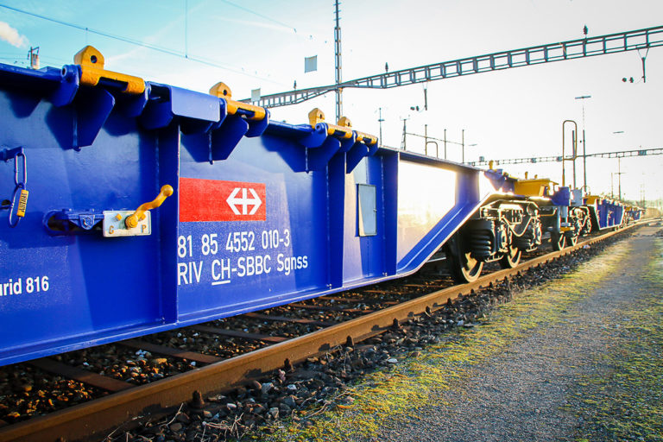
Intelligent Freight Trains
Equipped with sensors
Automation of operation
More efficient marshalling yards
better connection to existing logistics systems
Bild: SBB Cargo
Notes:
In order to keep up with digitisation, existing freight wagons must now also be upgraded. A large number of freight wagons are travelling on rail infrastructure without telematics. A freight car 4.0 is therefore equipped with sensors, e.g. for train testing, brake testing or an automatic clutch. This sensor technology facilitates and shortens train preparation and formation. Another point is communication between wagons and locomotive which is currently non-existent. The sensor technology can not only be used for the aforementioned purposes, but also enables predictive maintenance systems. These, in turn, allow improved use of the wagons, as maintenance can be better planned and surprising wagon breaks can be avoided. Telematics can also guarantee the connection to existing logistics systems.
Source: See Clausen (2017), online.
Image source: SBB Cargo (2019), online.

Slide 9
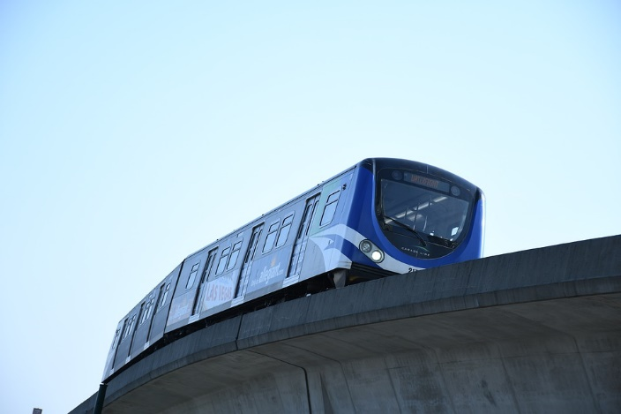
Autonomous Driving in Rail Traffic
Canada Line in Vancouver
Processes that a train driver would perform during the journey are taken over by the technology in automatic operation.
Bild: Pixabay
Notes:
Automation is becoming increasingly important not only in the automotive industry, but also in rail transport. All processes that a locomotive driver performs during the journey are taken over by the technology in fully automatic operation. Accordingly, lines, railway installations and vehicles must be equipped with special technical components. In the course of digitalization, increasingly powerful systems are being used. The various degrees of automation range from brake and travel control to speed control, from travel control and door control at the stopping point to potential remote control for driverless operation. Until the classic railway runs without a driver, however, there are still a few hurdles to overcome. These include customer acceptance, the handling of external faults and, last but not least, the approval of autonomous trains.
According to "Siemens," fully automated trains also have several advantages: They can travel faster in a row because braking distance and speed are constantly calculated. In addition, the technology saves electricity and can be used with high passenger volumes - without a train driver having to stand by - without any problems.
Advantages of autonomous driving in rail transport:
greater safety
increasing efficiency
capacities are fully utilised
human errors can be minimized
calculable => better planning, more reliable driving times
Disadvantages of autonomous driving in rail transport:
sensors may fail
situations can be misinterpreted
bugs can lead to malfunctions
accident liability: who is responsible?
customer acceptance not a reality yet
job cuts
Sources:
See Allianz pro Schiene (2019b), online.
Cf. Gaisch-Faustmann (2018), online; Cf. Die Welt (2016) online.

Slide 10
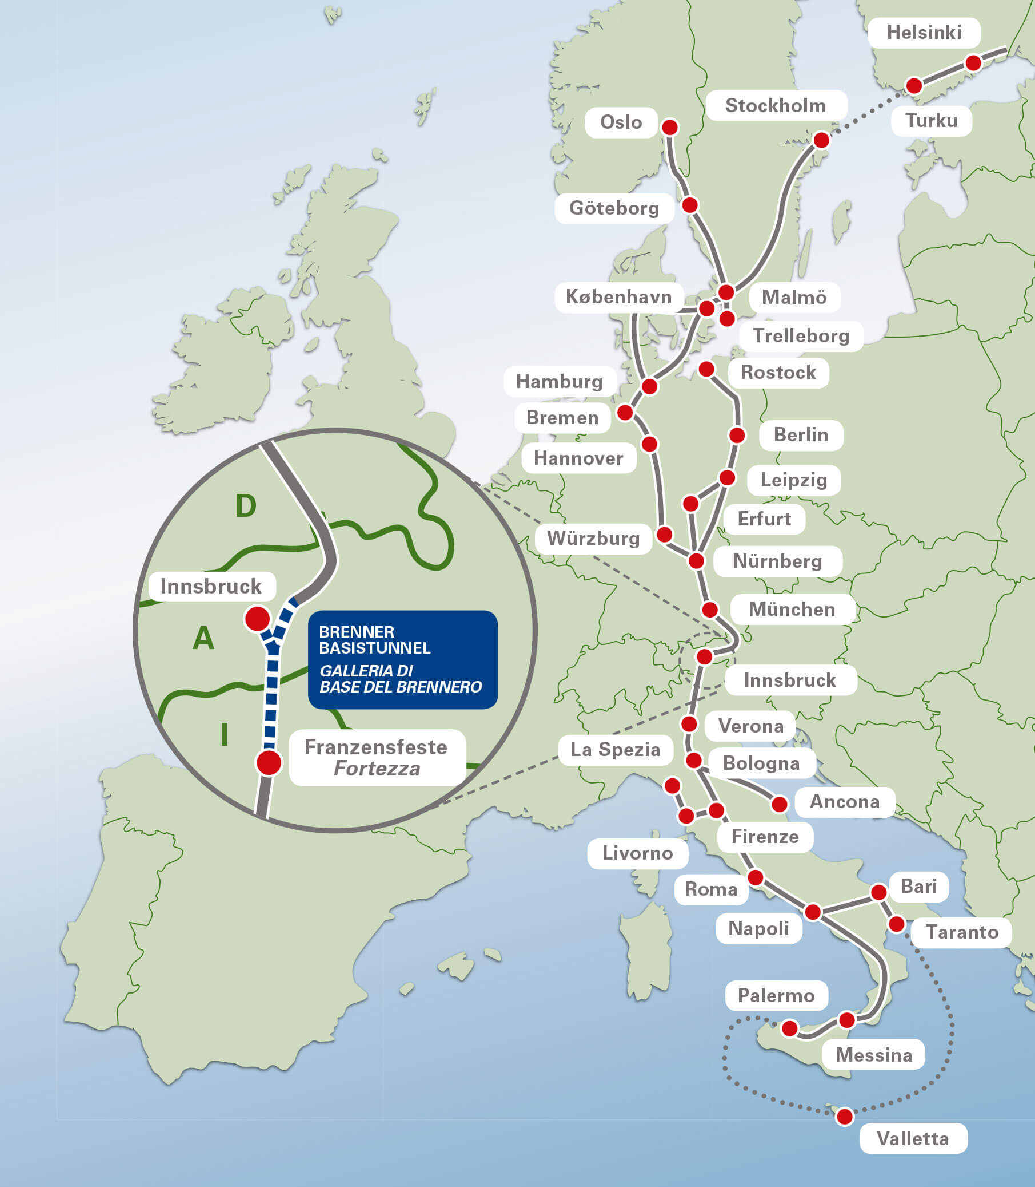
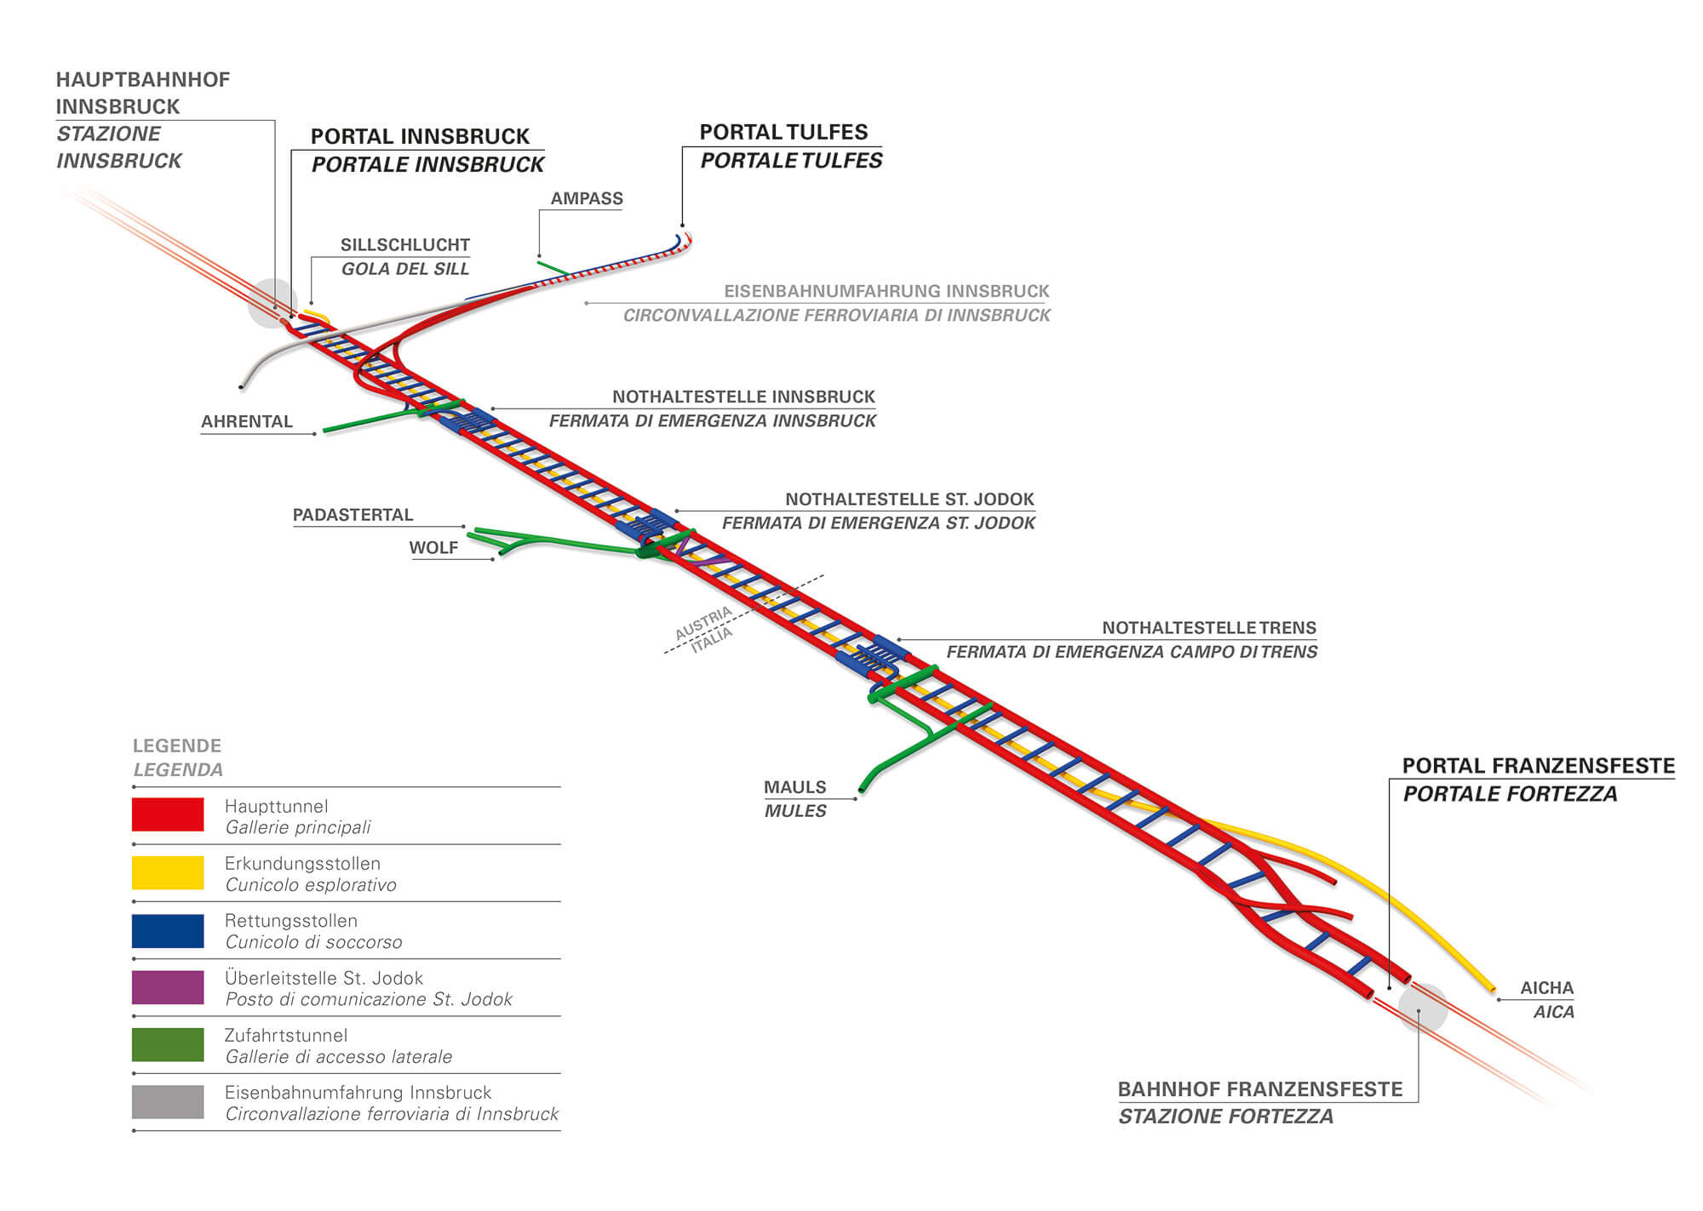
Development of Rail Infrastructure
Example: Brenner Base Tunnel
Images: Brenner Basistunnel BBT SE
Notes:
Austria is the leading country for rail transport in the EU. On average, each Austrian covers 2.255 kilometres per year by train, tram or underground - more than twice the EU average of 1.090 kilometres and about 45 per cent more than in other European countries. Every year, the Austrian Federal Railways (ÖBB) alone transport 459 million passengers and 115 million tons of goods.
In the coming years, billions will be invested in the new construction and expansion of rail infrastructure in order to further enhance the competitiveness of rail transport and continue the positive trend of recent years.
Below the Brenner Pass, the world's longest underground rail link for freight and passenger traffic is being built. The Brenner Base Tunnel improves travel and transport possibilities by rail in the heart of Europe and, with a length of 64 kilometres, is the longest underground railway connection in the world. It is a flat railway tunnel between Innsbruck and Franzensfeste in Italy. The Brenner Base Tunnel is a part of the European Scandinavian-Mediterranean core network corridor, where about 110 million people live between Helsinki and Valletta. The Brenner Base Tunnel thus enables a rapid and safe connection between population centres north and south of the Alps and links important European economic centres with each other. Cross-national projects are subsidised to an extent of up to 40 percent. The project will be implemented by Brenner Base Tunnel SE, a European public limited company working on behalf of the Republic of Austria, the Republic of Italy and the EU.
The Brenner base tunnel is to be completed in 2028, with a mere construction time of about 20 years. In the future, freight trains will be able to travel through the tunnel at speeds of up to 120 km/h and passenger trains at speeds of up to 250 km/h. The tunnel will also be used for goods transport. Altogether there will be 4 accessed tunnels, in Ampass, Ahrental, Wolf near Steinach am Brenner and in Mauls. In Innsbruck, the Brenner Base Tunnel then leads into the existing railway bypass. A special feature of the tunnel is the continuous exploratory tunnel. This runs centrally between the two main tunnel tubes and is 12 metres below. Current excavation work on the exploration tunnel should provide information on the rock condition and thus minimise construction times and costs. Once the tunnel is operational, the exploratory tunnel will be important for drainage.
Sources: See bmvit (2018), online.; See ÖBB Infrastuktur (2018), online; Cf. BBT (2018), online.
Image Source: https://www.bbt-se.com

Slide 11
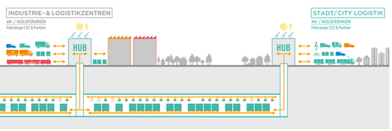
Underground Freight System
Example: Cargo Sous Terrain (planned)
Images: Cargo Sous Terrain AG
Automated, complete logistics system with goods transported in tunnels
Automated, driverless transport vehicles
Notes:
Cargo sous terrain is a complete logistics system for the flexible transport of small-component goods. Tunnels connect production and logistics sites with urban centres. Overground, CST distributes the transported goods in environmentally-friendly vehicles, contributing to the reduction of traffic and noise emissions.
Cargo sous terrain follows a similar principle to that of an automatic conveyor system. Automated, driverless transport vehicles which are able to pick up and deposit loads automatically from the designated ramps and lifts travel around the clock in the tunnels.
The vehicles, which travel on wheels and have an electric drive with induction rails, operate in three-track tunnels with a constant speed of around 30 kilometres per hour. The goods are transported on pallets or in modified containers.
Cargo sous terrain follows a similar principle to that of an automatic conveyor system. Automated, driverless transport vehicles which are able to pick up and deposit loads automatically from the designated ramps and lifts travel around the clock in the tunnels.
The vehicles, which travel on wheels and have an electric drive with induction rails, operate in three-track tunnels with a constant speed of around 30 kilometres per hour. The goods are transported on pallets or in modified containers.
The first section of the Cargo sous terrain network will run from Härkingen-Niederbipp to Zurich and is around 70 kilometres long. On this section, there are 10 connection points (hubs).
Quelle: https://www.cst.ch/en/what-is-cst/

Slide 12
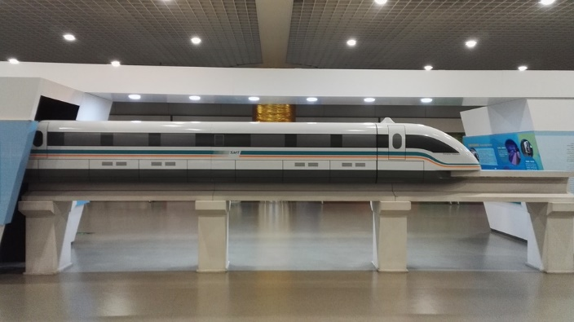
Magnetic Levitation Train (Maglev)
electromagnetic travelling fields that make the train float, control, drive and brake
Transrapid in Shanghai
Bild: Pixabay
Notes:
In contrast to the conventional railway, the magnetic levitation train can accelerate to speeds of over 400 km/h without touching the rails. This is made possible by electromagnetic travelling fields that make the train float, control, drive and brake. China has already shown the prototype of a magnetic levitation train that can travel 600 km/h in Qingdao in the eastern province of Shandong.
The realisation of magnetic levitation trains is associated with high investment costs, as it cannot use the existing railway infrastructure and requires a new infrastructure. For this reason, the planning of a magnetic levitation train should be based on structured, credible analyses and facts. Only then can such planning as a whole be socially meaningful and beneficial for the future. The top speed of the magnetic levitation train closes the gap between railway and aircraft and is particularly suitable for longer distances.
Advantages of magnetic levitation trains:
requires less space for routing than conventional railways
lower energy consumption
less noisy than railways at high speeds
high accelerations possible
shorter travel times
Disadvantages of magnetic levitation trains:
unsuitable for heavy goods traffic
cannot be used on existing railway infrastructure
no intermodality possible
high investment costs 12-55 million/km (comparison: high speed rail 6-25 million/km)
Sources: See Uhlenbrock/Nordmeier/Schlichting (2000), p.1.; See Stern (2019), online.; See The International Maglev Board e.V. (2018) online; See Vuchic/Casello (2002) S.45.

Slide 13

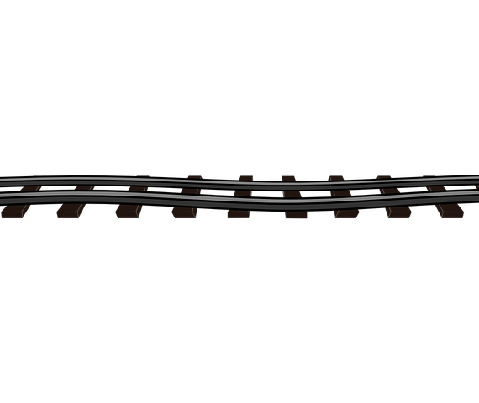
Enhanced Customer Service
Web-based booking system for transports in single wagonload traffic
better capacity utilisation through timely customer booking
customers can access route and date-specific transport information in real time
Example: Capacity Booking System for Rail Freight Transport (Rail Cargo Group)
Bild: Pixabay
Notes:
A modern infrastructure is a prerequisite for more efficient rail transport. The traffic forecast for 2025+ anticipates an increase in traffic volume in Austria. This forecast growth in traffic should primarily be handled by rail. An efficient railway is therefore of central importance for the transport system. More trains, shorter journey times and more modern stations and terminals should strengthen the market position of the railways. Investments in the rail network create the conditions for regular passenger traffic with stable and punctual travel times, support the transfer of freight traffic to rail and thus contribute to the reduction of CO₂ emissions. This should make the railways more attractive and efficient and ensure that they can cope with the forecast demand for freight and passenger transport.
Improved customer service adds to attractiveness and competitiveness of the railways. The following exampls from freight traffic illustrate this.
Capacity Booking System for Rail Freight Transport of the Rail Cargo Group
This is a project for the development of a booking system for Rail Cargo's freight traffic with a focus on transports in single wagonload traffic. The customer can accessed route and date-specific transport information in real time through the web-based portal. The Rail Cargo Group benefits from the optimisation of planning and better capacity utilisation through timely customer booking of the required volume. So the company increases transport flexibility and quality to create added benefit for its customers. The objective of the capacity booking system is clear: reforming the existing rail production system in terms of quality, punctuality and cost-effectiveness with a view to giving the attractiveness of rail freight transport a boost which will transfer more freight transport from road to rail.
Sources: See ÖBB Infrastruktur (2019), online; See Österreichische Verkehrszeitung (2013) online; See Rail Cargo Logistics - Austria GmbH (2013) online.

Slide 14

Telematics Systems in Rail Traffic
Telematics is an artificial word from the terms telecommunication, automation, and informatics.
Vorteile:
improved driving and transport safety
increased efficiency
optimized logistics processes through transparency
(e.g. improved disposition by exact positioning of the freight wagon)
Nachteile:
new tasks for locomotive drivers
uncertainty about data security
High investment costs
Bild: Pixabay
Notes:
Telematics systems usually describe self-sufficient systems that operate over a longer period of time without energy replenishment, communicate with the outside world and can locate themselves via GPS. Telematics enables customised solutions and customer requirements to be reliably met. This allows real time tracking of freight wagons or containers with high-quality goods. Solar-powered locating devices are mounted on and provide position data via satellite (GPS). At the same time, modern diagnostic systems measure parameters such as schedule deviations. Individually desired sensor data on charge status, temperature, door openings or vibrations can also be linked to the GPS position data and transmitted telematically. The data can be retrieved from any Internet-capable PC or mobile phone. The automated deviation management and early problem detection enable logistics specialists to take short-term measures.
With telematics systems, locomotive drivers perform a multitude of supervisory and management tasks. These range from direct manual operation of the train to largely autonomous operations management, where the active role of the driver is minimal.
Advantages:
improved driving and transport safety
enhanced attractiveness of rail transport
energy self-sufficient through solar operation
increased efficiency
optimized logistics processes through transparency
improved disposition by exact positioning of the freight wagon
Disadvantages:
new tasks for locomotive drivers from operating to managing the trains
uncertainty about data security
High investment costs
Sources: See Bergaus/Stottok (2010) p.28; Cf. VCÖ – Mobilität mit Zukunft (2010) online; See Bergaus/Stottok (2010) p.200; See Ebeling et al. (2005) p. 17.

Slide 15
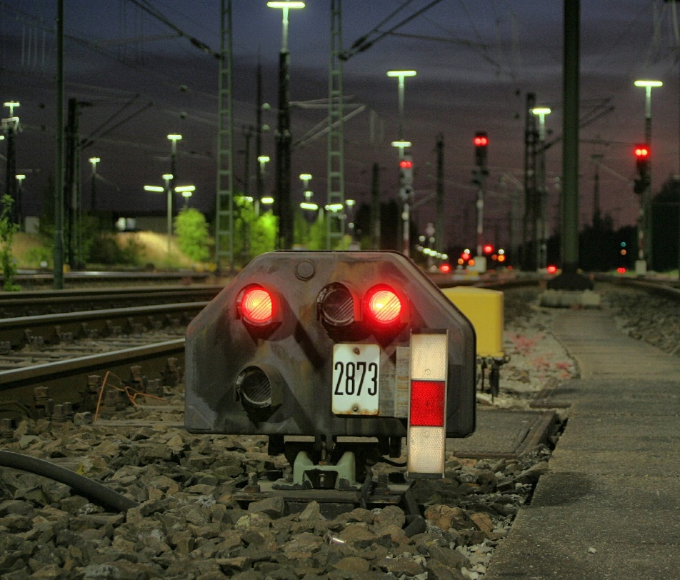
Interoperability
Removal of obstacles to the safe and uninterrupted movement of trains across borders
Harmonisation of infrastructure facilities, train protection and signalling systems, technical equipment of vehicles
Example: European Train Control System (ETCS)
Bild: Pixabay
Notes:
European rail transport is still hampered by historically evolved national systems. This puts international rail transport at a competitive disadvantage compared with contending modes of transport. Different energy supplies in different countries often require time-consuming locomotive changes at border stations. In addition, some countries, such as Russia, Ukraine, Kazakhstan and Spain, have broad gauge tracks. Such deviating track gauges make reloading of the goods or a gauge change of the entire train necessary. In addition, there are different train protection systems.
The removal of obstacles in cross-border traffic and further harmonisation of national requirements are among the main transport policy objectives of the European Union. This means that infrastructure, train protection and signalling systems as well as the technical equipment of locomotives are to be standardised.
One step towards harmonisation is the European Train Control System (ETCS). ETCS monitors the locally permitted maximum speed, the correct route and direction as well as the suitability of the train for the route and is intended to harmonise a large number of train control systems in Europe.
Sources: See Rail Cargo Group (2018), online; Stoll et al. (2017), p. 36ff.
Image source: pixabay

Slide 16
Agenda
Trends & Innovations in Rail Freight Transport
Best Practices

Slide 17
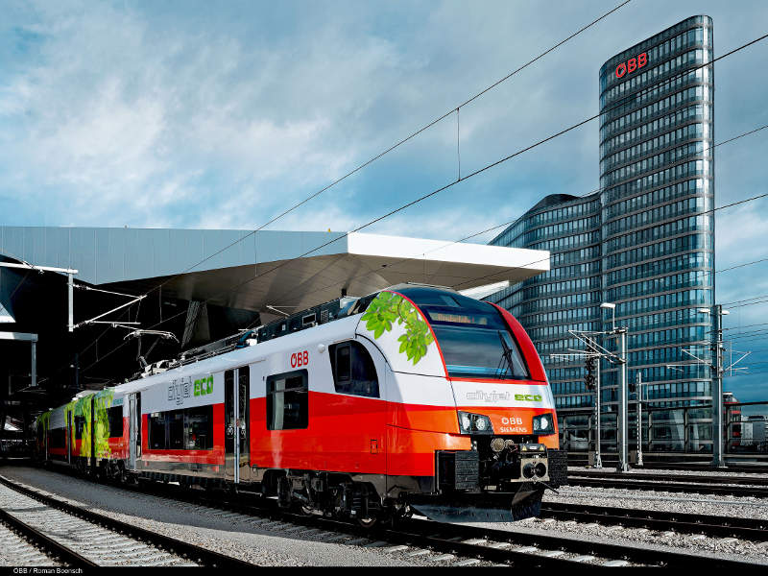
Cityjet Eco (ÖBB)
Battery-powered electric hybrid train
train absorbs energy on the electrified line via the pantograph and then stores it in batteries
this energy is then used on non-electrified lines
Image: Railway Technology
Notes:
Cityjet Eco - ÖBB's New Hybrid Train
Several diesel locomotives are still running on Austria's rail network, as part of the network has not been electrified yet. However, a large part of this is being electrified within the framework of the bmvit in order to minimise the number of diesel trains for more environmentally friendly transport throughout Austria. Siemens is already taking action with its newly developed train - the Cityjet Eco. This is the world's first battery-powered electric hybrid train which absorbs energy on the electrified line via the pantograph and then stores it in batteries. This energy is then used on non-electrified lines, where the batteries feed the entire energy supply system of the train. The Cityjet Eco has a range of about 80 kilometres before it has to go back under the power line.
A special cooling system for the batteries is necessary in order to reach the maximum speed of 140 km/h. The drive does not need so much energy, because most of the electricity goes into lighting, air conditioning, Wi-Fi etc. Cooling is also vital for prolonged battery life to 15 years, as this means that they would only have to be changed once during the entire service life of the train.
Currently there is only a prototype, and in the coming months the train will be tested and further developed to series production. The first passenger operation is expected for the second half of 2019.
Sources: See Leadersnet (2018), online.
Image Source: Railway Technology (2018), online.

Slide 18
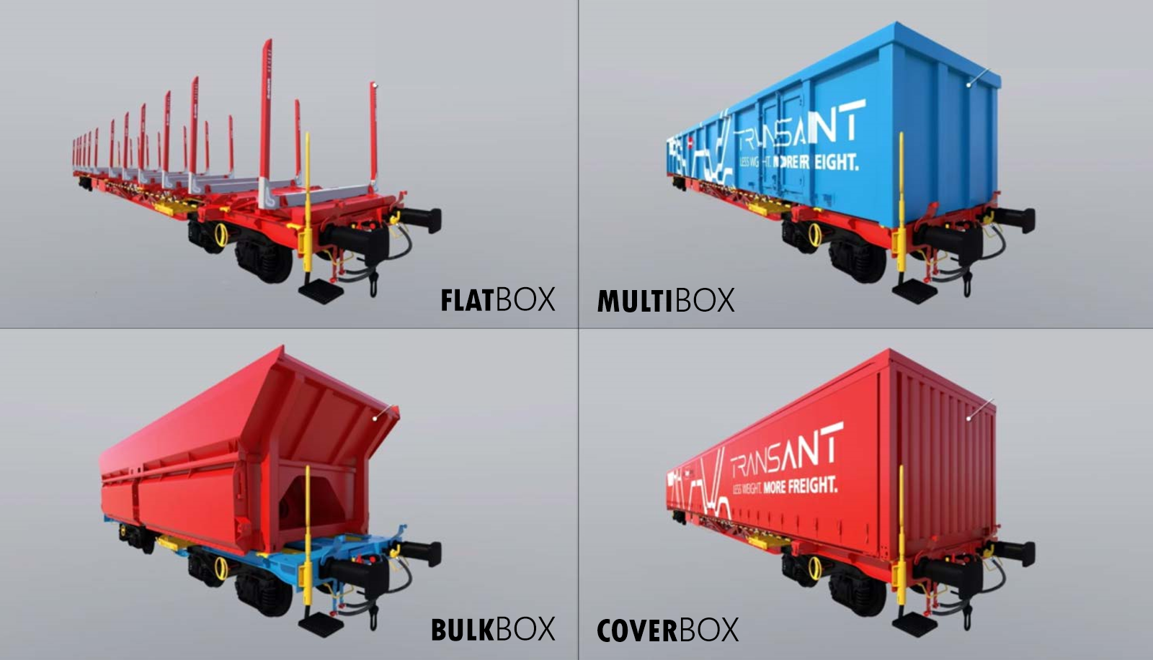
TransANT (Voestalpine, Rail Cargo Group)
Modular freight wagon
universal applicability
lightweight construction concept
Image: Rail Cargo Group
Notes:
Rail Cargo Group and voestalpine are setting new standards in rail logistics with the innovation of the modular and flexible freight wagon TransANT. Its modular lightweight construction concept and its universal applicability make the innovative platform trolley unique.
TransANT consists of a standardized platform available in seven different lengths - from 33 to 70 feet. A modular structure is placed on the platform, which is interchangeable and available in numerous industry-specific versions. This modular system increases structure flexibility, usability and maintenance. Lightweight construction lends a weight advantage of around 20%, enabling increased payload. In addition, manufacturing costs can be saved through reduction of traction costs for energy and the infrastructure usage fee (IBE).
According to forecasts, European freight traffic is expected to increase by around 30% by 2030, which means that there is great potential for the modes of transport - but above all for rail.
Modular structures are the flat box with stanchions for transporting wood, for example, the cover box for palletized goods, the multi box for bulk goods of all kinds and the bulk box for bulk goods such as ores.
From autumn 2019, the first 60 freight wagons will carry domestic ores to voestalpine in Linz, operated by CargoServ - a subsidiary of LogServ.
Sources: See Rieder (2018), online; See Rail Cargo Austria (2018), online; See LogServ (2018), online; See Steininger (2018), online.
Image Source: Rail Cargo Group (2019a), online.

Slide 19
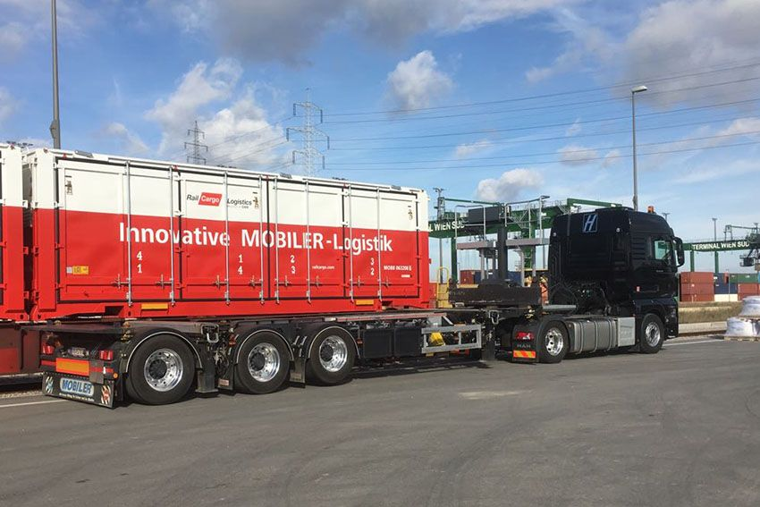
MOBILER (Rail Cargo Group)
Innovative wagonload system
hydraulic lifting device for uncomplicated and fast transhipment between wagon and truck without a crane
Image: Rail Cargo Group
Notes:
The name MOBILER stands for a wagonload system that combines the advantages of rail and road freight transport in one system. The MOBILER enables direct connection to the customer, regardless of whether a siding is available. A special MOBILER truck picks up the goods to bring them to the next loading point, from where they are transported by rail.
MOBILER's faster, safer and more economical technology means that more goods can be transported by rail in a more environmentally friendly way, without foregoing the advantages of more flexible and faster truck delivery. In addition to just-in-time deliveries, the monitoring of the progress of each individual shipment and the electronic arrival notification by SMS or e-mail are also part of the service portfolio.
MOBILER enables the truck driver to handle MOBILER containers and WABs at any time and place in just a few minutes. Handling takes place laterally on each loading track. The MOBILER is particularly suitable for dangerous goods of all kinds. MOBILER is mainly used for FMCG (fast moving consumer goods) incl. beverage logistics for the transport of bottles and drums as well as heavy bulk goods and residual materials such as slag, scrap, waste paper and building products. Palletized goods, industrial products and liquids are also transported in tank containers.
The MOBILER vehicle is equipped with a hydraulic lifting device for uncomplicated and fast transhipment between wagon and truck without a crane. This means that door-to-door deliveries are possible throughout Europe and a wide variety of goods can be transported along the supply chain.
Sources: See Rail Cargo Logistics Austria (2018), online; See Rail Cargo Group (2019c), online.
Image Source: Rail Cargo Group (2019b)

Slide 20
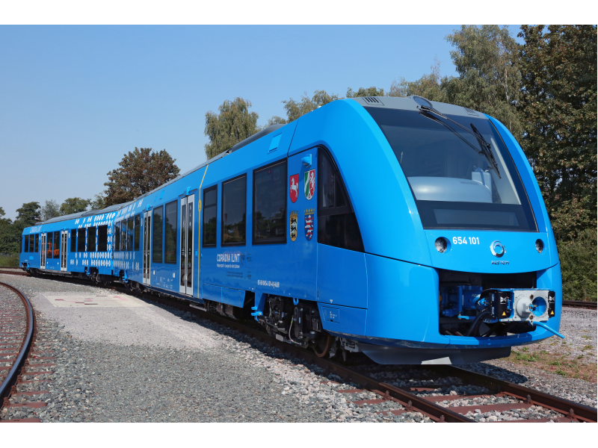
Coradia iLint (Alstom)
Fuel cell-powered train for mass transit
runs on electricity but does not get its electricity from the overhead line, but produces it itself using fuel cell technology
Alternative for diesel trains in local public transport
Bild: Alstom
Notes:
The French Alstom Group has developed a fuel cell-powered train for mass transit, revolutionizing the international rail market. The so-called Coradia iLint is a fuel cell train that runs on electricity but does not get its electricity from the overhead line, but produces it itself using fuel cell technology. The Coradia iLint is conceived as an alternative to diesel trains in local rail transport, as there are still many diesel trains in use in rural areas.
Two fuel cells are installed in the railcar train, which, together with a large hydrogen tank, are located on the roof of the train. Each fuel cell delivers an output of 200 kilowatts (kW), but 800 kW is needed to start the engine. The remaining power comes from a so-called lithium-ion battery which is installed in the train floor. Excess power not needed while driving is stored in the battery. If more energy is needed, e.g. on a gradient, it is supplied by the battery. The kinetic energy from braking is also converted into electrical energy and stored in the battery. With a top speed of 140 km/h, the Coradia iLint is just as fast as a diesel train. The big difference to the diesel train, however, is the environmentally friendly operation and the significantly lower noise emissions. The train developed by Alstom is a pioneer in its niche with a ready market for such a model.
Coradia iLint is the world's first hydrogen fuel cell train that has been running regularly to a fixed schedule on public transport services in Lower Saxony (Germany) from autumn 2018.
Sources: Cf. Pluta (2018), online; See Alstom (2018), online.
Image Source: Alstom (2019), online.

Slide 21
Sources
Allianz pro Schiene (2019a): Ein Überblick: Innovative Antriebe auf der Schiene, in: https://www.allianz-pro-schiene.de/themen/aktuell/innovative-antriebe-auf-der-schiene/, Zugriff am: 21.07.2019
Allianz pro Schiene (2019b): Autonomes Fahren auf der Schiene: Wie die Bahnen schon heute selbstständig unterwegs sind, in: https://www.allianz-pro-schiene.de/themen/aktuell/autonomes-fahren-auf-der-schiene/, Zugriff am: 21.07.2019
Alstom (2019): Coradia iLint – der weltweit erste Wasserstoffzug , in: https://www.alstom.com/de/our-solutions-rolling-stock/coradia-ilint-der-weltweit-erste-wasserstoffzug, Zugriff am: 20.07.2019
Alstom (2018): Weltpremiere: Alstoms Wasserstoff-Züge starten im öffentlichen Linienverkehr in Niedersachsen, in: https://www.alstom.com/de/press-releases-news/2018/9/weltpremiere-alstoms-wasserstoff-zuege-starten-im-oeffentlichen, Zugriff am: 15.11.2019
Bergaus M./Stottok B. (2010): Verbesserter Nutzen von Telematiksystemen im Schienenverkehr durch Bereitstellung innovativer Service-Delivey-Plattformen; Krems
BBT (2018): Projektüberblick, in: https://www.bbt-se.com/tunnel/projektueberblick/, Zugriff am 04.11.2018
Bmvit (2018): Zügiger Ausbau: So bleibt Österreich Bahnland Nummer 1, in: https://infothek.bmvit.gv.at/eisenbahn-investitionen-bahnland-nummer-1/, Zugriff am: 21.07.2019
Bobsien, S. / Schmidt, H. / Koch to Krax, G. (2018): Mit intelligenten Güterwagen in die Verkehrswende starten, in: https://www.dbcargo.com/resource/blob/3348136/efab4ff3b423398dc9cd94311550908a/Artikel_ETR_9_2018_Verkehrswende-data.pdf, Zugriff am: 20.07.2019
Cargo Sous Terrain (2019): http://www.cargosousterrain.ch, Zugriff am 21.07.2019
Clausen, U. (2017): Die Zukunft des Schienengüterverkehrs – Schienengüterverkehr 4.0 – Digitalisierung, Automatisierung, moderne Fahrzeugtechnik, Hannover: Fraunhofer IML & Institut für Transportlogistik der TU Dortmund
DB Cargo (2019): Mit intelligenten Güterwagen in die Verkehrswende starten, in: https://www.dbcargo.com/rail-deutschland-de/news-und-medien/News/mit-intelligenten-Gueterwagen-in-die-verkehrswende-starten-3348128, Zugriff am: 20.07.2019
DB Inside Bahn (2016): Visionen und Ideen: Bahnhöfe der Zukunft, in: https://inside.bahn.de/bahnhof-zukunft/, Zugriff am: 21.07.2019
Die Welt (2016): Deutsche Bahn will automatisierte Züge ohne Lokführer durch Land rollen lassen, bezogen unter: https://www.welt.de/newsticker/news1/article156114541/Deutsche-Bahn-will-automatisierte-Zuege-ohne-Lokfuehrer-durchs-Land-rollen-lassen.html, Zugriff am 10.11.2018
Ebeling K./Kühne D./Leibbrand H./Lemmer K./Lohrberg K./Stopka U./Uebel H./Zocke P. (2005): Flexibilisierung des Schienenverkehrs durch Telematik; Stuttgart
Gaisch-Faustmann, H. (2018): Selbstfahrende Züge werden die Lokführer ersetzen, in: https://www.kleinezeitung.at/wirtschaft/5446464/Selbstfahrende-Zuege-werden-den-Lokfuehrer-ersetzen, Zugriff am: 03.11.2018
Leadersnet (2018): Cityjet eco: ÖBB und Siemens präsentieren Zug mit elektro-hybridem Batterieantrieb, in: https://www.leadersnet.at/news/32953,cityjet-eco-oebb-und-siemens-praesentieren-zug-mit.html, Zugriff am: 10.11.2018
LogServ (2018): Weniger ist mehr, in: http://www.logserv.at/Presse/Aktuelles/Weniger-ist-mehr, Zugriff am 12.11.2018
ÖBB Infrastruktur (2018): Brenner Basistunnel, in: https://infrastruktur.oebb.at/de/projekte-fuer-oesterreich/bahnstrecken/brennerstrecke-kufstein-brenner/brenner-basistunnel, Zugriff am 03.11.2018
ÖBB Infrastruktur (2019): Zukunft Bahn Zielnetz 2025+, in: https://infrastruktur.oebb.at/de/unternehmen/fuer-oesterreich/zukunft-bahn-zielnetz, Zugriff am: 21.07.2019
Österreichische Verkehrszeitung (2013): Rail Cargo Group investiert in Transportbuchungssystem, in: http://www.oevz.com/news/rail-cargo-group-investiert-in-transportbuchungssystem-2/, Zugriff am 03.11.2018
o.V. (2017): Hybridantriebssysteme im Schienenverkehr, in: https://www.forschungsinformationssystem.de/servlet/is/342673/, Zugriff am: 21.07.2019
Pluta, Werner (2018): Alstoms Brennstoffzellenzug ist "erschreckend unspektakulär", in: https://www.golem.de/news/coradia-ilint-alstoms-brennstoffzellenzug-ist-erschreckend-unspektakulaer-1804-133923.html, Zugriff am: 15.11.2018

Slide 22
Sources
Rail Cargo Austria AG (2018): TransANT, in: https://www.railcargo.com/file_source/railcargo/rcg/Downloads/transant-folder.pdf, Zugriff am 12.11.2018
Rail Cargo Logistics Austria (2018): MOBILER - Innovation für Ihre Logistik, in: http://www.railcargologistics.at/de/Unsere_Leistungen/MOBILER/, Zugriff am: 15.11.2018
Rail Cargo Logistics – Austria GmbH: Rail Cargo Group gewinnt die Kategorie “Nachhaltiger Güterverkehr“ beim VCÖ-Mobilitätspreis, in: http://www.railcargologistics.at/de/Aktuelles/News/2013/Q3/Rail_Cargo_Group_gewinnt_VCOe_Mobilitaetspreis/index.jsp, Zugriff am 03.11.2018
Railcargo Group (2019a): TransANT Less Weight. More Freight, in: https://www.railcargo.com/de/leistungen/waggonvermietung-verkauf/transant, Zugriff am: 20.07.2019
Rail Cargo Group (2019b): MOBILER, in: https://www.railcargo.com/de/leistungen/wagenladungen/mobile, Zugriff am: 20.07.2019
Rail Cargo Group (2019c): MOBILER – Kombinierter Verkehr innovative umgesetzt, in: https://www.railcargo.com/file_source/railcargo/rcg/Downloads/2019-mobiler-de.pdf, Zugriff am: 20.07.2019
Rail Cargo Group (2018): Interoperabilität, in: https://blog.railcargo.com/artikel/eisenbahn-einfach-erklaert-interoperabilitaet.html, Zugriff am: 21.07.2019
Rieder, B. (2018): ÖBB Rail Cargo Group präsentiert TransANT auf der InnoTrans Messe in Berlin, in: https://presse.oebb.at/de/presseinformationen/oebb-rail-cargo-group-praesentiert-transant-auf-der-innotrans-messe-in-berlin, Zugriff am: 11.11.2018
Steininger, V. (2018): Weltpremiere: Zukunftsweisender Leichtbauwagon TransANT von voestalpine und Rail Cargo Group, in: https://www.voestalpine.com/blog/de/mobilitaet/weltpremiere-zukunftsweisender-leichtbauwagon-transant-von-voestalpine-und-rail-cargo-group/, Zugriff am 12.11.2018
Stern (2019): Diese Magnetschwebebahn fährt 600 km/h und macht dem Flugzeugverkehr Konkurrenz, in: https://www.stern.de/digital/technik/magnetschwebebahn-faehrt-600-km-h-und-wird-den-flugzeugverkehr-ersetzen-8726200.html, Zugriff am: 21.07.2019
Stoll, F. / Schüttert, A. / Nießen, N. (2017): Interoperabler Schienen­verkehr in Europa, in: Internationales Verkehrswesen, 69) 3 | 2017, S. 36-39
The International Maglev Board e.V. (2018): Fakten, in: http://www.maglev.in/: Zugriff am: 04.11.2018
Uhlenbrock M./Nordmeier V./Schlichting H. (2000): Die Magnetschnellbahn Transrapid im Experiment; Essen
VCÖ – Mobilität mit Zukunft (2010): Schaffung von Wettbewerbsvorteilen im Schienenverkehr durch Einsatz von solarbetriebener Telematik, bezogen unter: https://mobilitaetsprojekte.vcoe.at/schaffung-von-wettbewerbsvorteilen-im-schienenverkehr-durch-einsatz-von-solarbetriebener-telematik?suchstr=schienenverkehr&oder1=220&oder4=2010, Zugriff am 03.11.2018
Vuchic V./Casello J. (2002): An Evaluation of Maglev Technology and Its Comparison With High Speed Rail; University of Pennsylvania
Wegfinder (2017): Wegfinder: Wiener Navigations-App verkauft jetzt Tickets von ÖBB und Öffis, in: https://www.trendingtopics.at/wegfinder-wiener-navigations-app-verkauft-jetzt-tickets-von-oebb-und-oeffis/, Zugriff am: 05.11.2018
Zukunft Mobilität (2019): Geschichte der Eisenbahn – Teil I: Anfang 17. Jahrhundert – 1835, bezogen unter: https://www.zukunft-mobilitaet.net/1674/vergangenheit-verkehrsgeschichte/geschichte-der-eisenbahn-teil-i-anfang-17-jahrhundert-1835/, Zugriff am 19.07.2019

Slide 23

Additional information
We hope our PowerPoint presentation meets your requirements!
You are welcome to adapt this presentation according to your wishes and requirements and to use it for your lessons/lectures.
We are happy to receive your questions or feedback at rerail@fh-vie.ac.at .
Further PowerPoint slides and teaching materials at http://www.retrans.at/en/

